Slide 1
Statistical Genetics
Lecture 3
Multiple Comparison Procedures

Slide 2
Lecture 3 Readings
Foulkes, A.S. (2009). Applied Statistical Genetics with R: Chapter 4

Slide 3
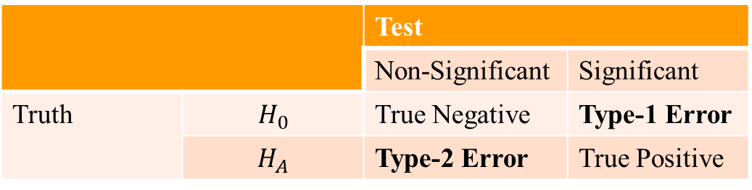
Multiple Comparison Procedures
Several traditional statistical methods were described for testing for an association between a genotype and a trait.
These methods generally require comparing a test statistic to its known (or simulated) distribution in order to quantify the probability of seeing what we do or something more extreme under the assumption that the null hypothesis is true.
Our decision to accept or reject the null then rests on a comparison of this quantity, called the p-value, to a threshold based on a previously determined acceptable level of error.
Most methods adjusting for multiple comparisons describe controlling one of two error rates: the family-wise error rate (FWER) and the false discovery rate (FDR).
 |  | Test
 |  | Non-Significant | Significant
Truth | $$H_{0}$$ | True Negative | Type-1 Error
 | $$H_{A}$$ | Type-2 Error | True Positive
Type-1 and Type-2 errors in hypothesis testing
Notes:
The genetic material that carries the instructions that allow cells to make proteins
Composed of a sugar phosphate backbone from which four nitrogenous bases- adenine (A), guanine (G), cytosine (C), and thymine (T) protrude
Arranged in a double helix- two strands are held together by specific pairings between bases A – T pair and G – C pair

Slide 4
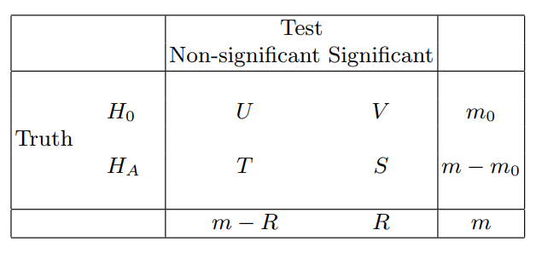

Multiple Comparison Procedures
False Discovery Rate (FDR): defined as the expected proportion of null hypotheses that are true among those that are declared significant.
Returning to the notation of the above Table and assuming R, the number of tests that are declared significant, is greater than 0, FDR is given by
$$FDR=E\left(\frac{V}{R}\right)$$
Table 1: Errors for multiple hypothesis tests
Notes:
The genetic material that carries the instructions that allow cells to make proteins
Composed of a sugar phosphate backbone from which four nitrogenous bases- adenine (A), guanine (G), cytosine (C), and thymine (T) protrude
Arranged in a double helix- two strands are held together by specific pairings between bases A – T pair and G – C pair

Slide 5
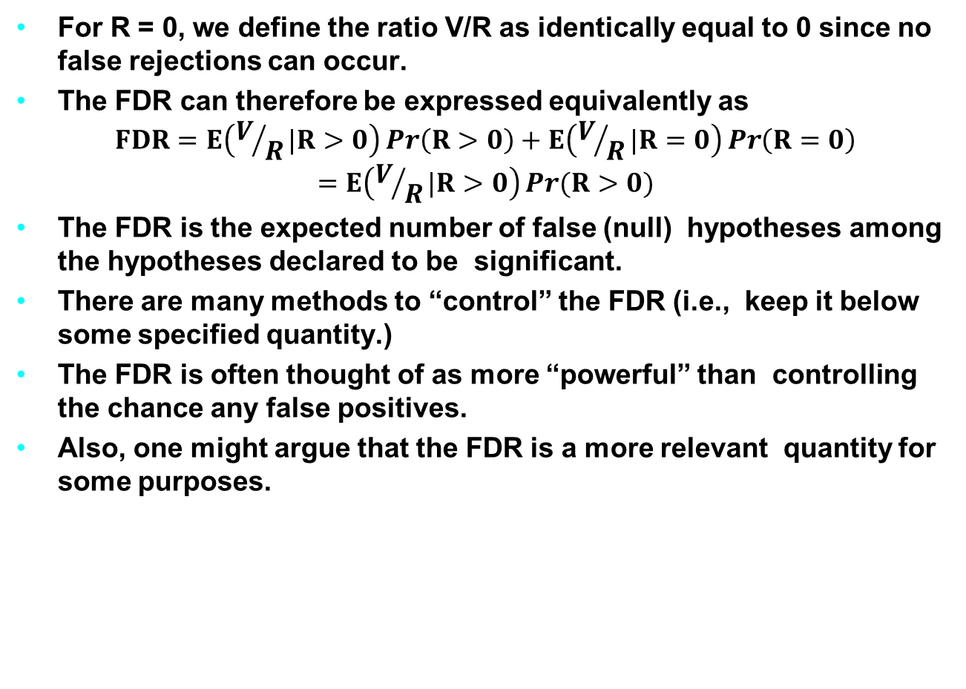
False Discovery Rate
For R = 0, we define the ratio V/R as identically equal to 0 since no false rejections can occur.
The FDR can therefore be expressed equivalently as
$$FDR=E\left(V/R|R>0\right)\operatorname{Pr}\left(R>0\right)+E\left(V/R|R=0\right)\operatorname{Pr}\left(R=0\right)$$
$$=E\left(V/R|R>0\right)\operatorname{Pr}{(R>0)}$$
The FDR is the expected number of false (null) hypotheses among the hypotheses declared to be significant.
There are many methods to “control” the FDR (i.e., keep it below some specified quantity.)
The FDR is often thought of as more “powerful” than controlling the chance any false positives.
Also, one might argue that the FDR is a more relevant quantity for some purposes.
Notes:
The genetic material that carries the instructions that allow cells to make proteins
Composed of a sugar phosphate backbone from which four nitrogenous bases- adenine (A), guanine (G), cytosine (C), and thymine (T) protrude
Arranged in a double helix- two strands are held together by specific pairings between bases A – T pair and G – C pair

Slide 6
Benjamini-Hochberg Method
The simplest method, due to Benjamini and Hochberg, uses the p-values directly.
Remember there are as many p-values as there are tests
First we order the p-values from smallest to largest, and call the
i-th smallest p-value pi, i = 1,…,m.
Then for each i we compare pi to αi/m, where α is the value at which we want to control the FDR (α may be as high as 0.1 or 0.15)
Then we find the biggest i for which pi is less than or equal to
αi/m
Once we find that biggest i, we reject that hypothesis, and all the hypotheses (tests) with smaller p-values.
Notes:
The genetic material that carries the instructions that allow cells to make proteins
Composed of a sugar phosphate backbone from which four nitrogenous bases- adenine (A), guanine (G), cytosine (C), and thymine (T) protrude
Arranged in a double helix- two strands are held together by specific pairings between bases A – T pair and G – C pair

Slide 7
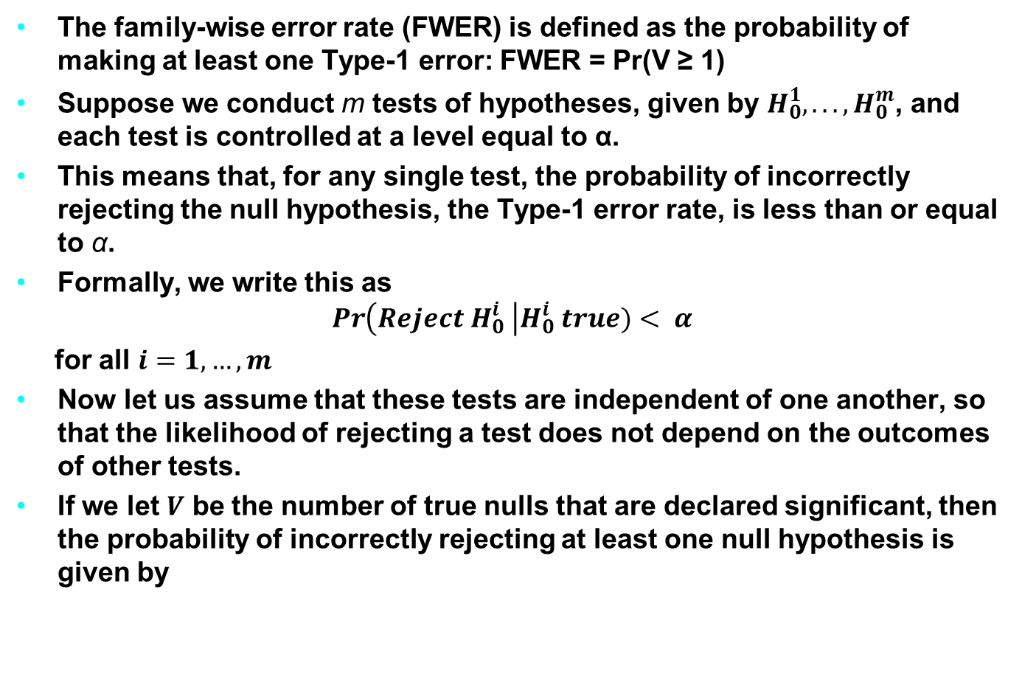
Bonferroni Adjustment
The family-wise error rate (FWER) is defined as the probability of making at least one Type-1 error: FWER = Pr(V ≥ 1)
Suppose we conduct m tests of hypotheses, given by $H_{0}^{1}, . . . , H_{0}^{m}$, and each test is controlled at a level equal to α.
This means that, for any single test, the probability of incorrectly rejecting the null hypothesis, the Type-1 error rate, is less than or equal to α.
Formally, we write this as
$$\operatorname{Pr}\left(Reject H_{0}^{i} \right|H_{0}^{i} true)< α$$
for all $i=1, …, m$
Now let us assume that these tests are independent of one another, so that the likelihood of rejecting a test does not depend on the outcomes of other tests.
If we let $V$ be the number of true nulls that are declared significant, then the probability of incorrectly rejecting at least one null hypothesis is given by
Notes:
The genetic material that carries the instructions that allow cells to make proteins
Composed of a sugar phosphate backbone from which four nitrogenous bases- adenine (A), guanine (G), cytosine (C), and thymine (T) protrude
Arranged in a double helix- two strands are held together by specific pairings between bases A – T pair and G – C pair

Slide 8

Bonferroni Adjustment
The Bonferroni adjustment for multiple comparisons is probably the most straightforward single-step adjustment to apply.
It involves simply using $α^{′}$ = α/m in place of α for the level of each test, where m is the number of tests to be performed.
Other single-step procedures that control FWER are Tukey’s and Scheffe’s methods
Notes:
The genetic material that carries the instructions that allow cells to make proteins
Composed of a sugar phosphate backbone from which four nitrogenous bases- adenine (A), guanine (G), cytosine (C), and thymine (T) protrude
Arranged in a double helix- two strands are held together by specific pairings between bases A – T pair and G – C pair

Slide 9
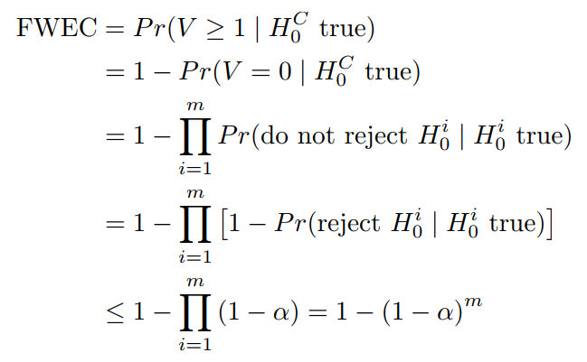
Family-wise Error Rate
Notably, if m = 1, then this equation reduces to FWEC ≤ α.
However, if m = 2 independent tests are performed, each at level α = 0.05, then we are only certain that the probability of making at least one type-1 error is less than or equal to 1 - (1 – 0.05)^2 = 0:0975.
Notes:
The genetic material that carries the instructions that allow cells to make proteins
Composed of a sugar phosphate backbone from which four nitrogenous bases- adenine (A), guanine (G), cytosine (C), and thymine (T) protrude
Arranged in a double helix- two strands are held together by specific pairings between bases A – T pair and G – C pair

Slide 10
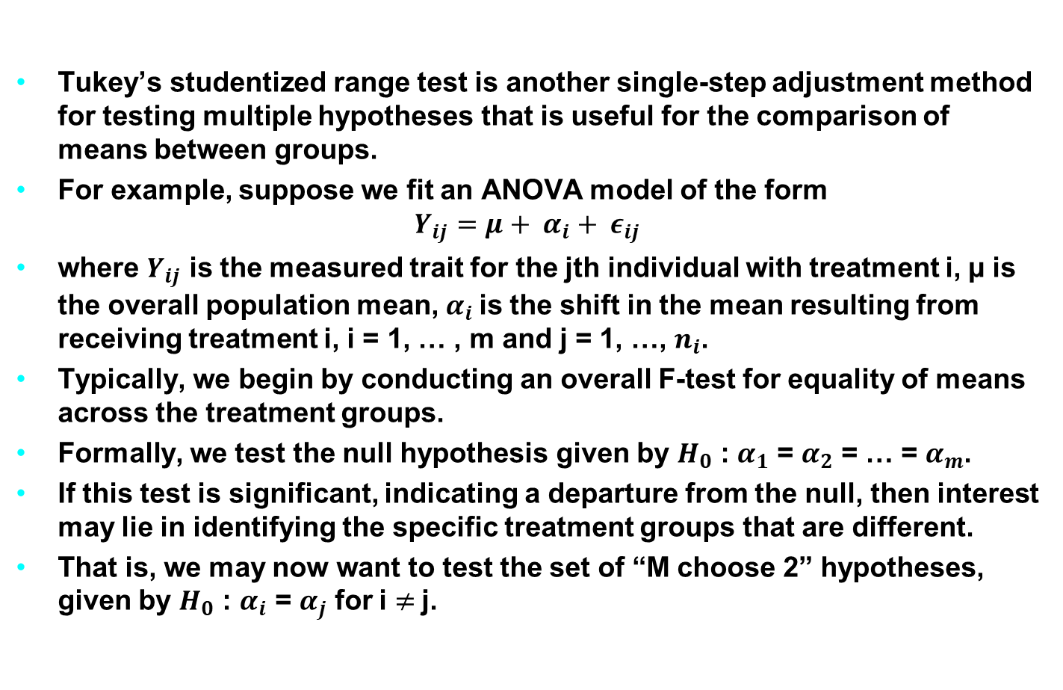
Tukey’s Adjustment
Tukey’s studentized range test is another single-step adjustment method for testing multiple hypotheses that is useful for the comparison of means between groups.
For example, suppose we fit an ANOVA model of the form
$$Y_{ij}=μ+ α_{i}+ ε_{ij}$$
where $Y_{ij}$ is the measured trait for the jth individual with treatment i, µ is the overall population mean, $α_{i}$is the shift in the mean resulting from receiving treatment i, i = 1, … , m and j = 1, …, $n_{i}$.
Typically, we begin by conducting an overall F-test for equality of means across the treatment groups.
Formally, we test the null hypothesis given by $H_{0}$ : $α_{1}$ = $α_{2}$ = … = $α_{m}$.
If this test is significant, indicating a departure from the null, then interest may lie in identifying the specific treatment groups that are different.
That is, we may now want to test the set of “M choose 2” hypotheses, given by $H_{0}$ : $α_{i}$ = $α_{j}$ for i $≠$j.
Notes:
The genetic material that carries the instructions that allow cells to make proteins
Composed of a sugar phosphate backbone from which four nitrogenous bases- adenine (A), guanine (G), cytosine (C), and thymine (T) protrude
Arranged in a double helix- two strands are held together by specific pairings between bases A – T pair and G – C pair

Slide 11
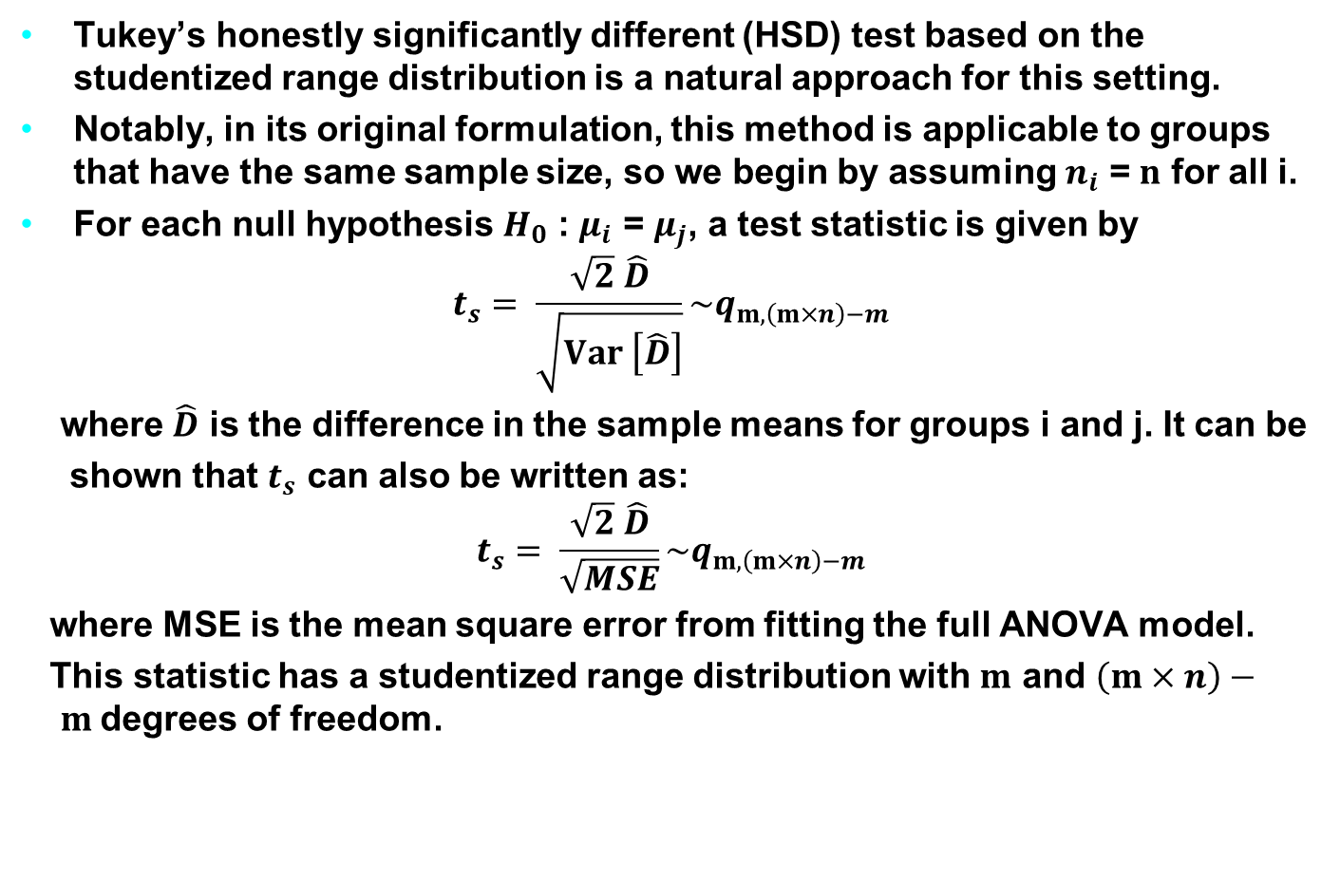
Tukey’s Adjustment
Tukey’s honestly significantly different (HSD) test based on the studentized range distribution is a natural approach for this setting.
Notably, in its original formulation, this method is applicable to groups that have the same sample size, so we begin by assuming $n_{i}$ = $n$ for all i.
For each null hypothesis $H_{0}$ : $μ_{i}$ = $μ_{j}$, a test statistic is given by
$$t_{s}= \frac{\sqrt{2} \hat{D}}{\sqrt{Var \left[\hat{D}\right]}}\sim q_{m, \left(m×n\right)−m}$$
where $\hat{D}$ is the difference in the sample means for groups i and j. It can be
shown that $t_{s}$ can also be written as:
$$t_{s}= \frac{\sqrt{2} \hat{D}}{\sqrt{MSE}}\sim q_{m, \left(m×n\right)−m}$$
where MSE is the mean square error from fitting the full ANOVA model.
This statistic has a studentized range distribution with $m$ and $\left(m×n\right)− m$degrees of freedom.
Notes:
The genetic material that carries the instructions that allow cells to make proteins
Composed of a sugar phosphate backbone from which four nitrogenous bases- adenine (A), guanine (G), cytosine (C), and thymine (T) protrude
Arranged in a double helix- two strands are held together by specific pairings between bases A – T pair and G – C pair

Slide 12
Examples from Association Tests
Notes:
The genetic material that carries the instructions that allow cells to make proteins
Composed of a sugar phosphate backbone from which four nitrogenous bases- adenine (A), guanine (G), cytosine (C), and thymine (T) protrude
Arranged in a double helix- two strands are held together by specific pairings between bases A – T pair and G – C pair

